Slide 1
Big Mountain Resort Guided Capstone
By Abolaji Shiwoku

Slide 2
Problem Identification
Using the data from all of the ski resorts in the United States, we must construct a model that will establish a criteria system for insight of Big Mountain Resort’s ticket price relative to its competitors
Some of the data provided:
Number of trams
Total number of chair lifts
Total number of ski runs
Total square area of skiable terrain
Adult weekend price
Adult weekday price
Average snowfall and other features (these features were supplied for each resort in the data)

Slide 3
Key Findings
The model we chose for this problem was a Random Forest model, and we used the numerical data to fit the model and provide insight on the current pricing structure of Big Mountain Resort.
According to our model, the Big Mountain Resort was actually pricing its weekend adult tickets too cheaply with the added attractions.
Putting the results in context, we saw, from the data, that Big Mountain Resort charges more than any other resort in the state of Montana. In context of the whole country, the resort prices seem be average.

Slide 4
Modeling Results
To evaluate potential changes in business operations and their effect on the ticket price, we supplied the model with 4 scenarios:
close 10 of the least used runs
Adding a run, increasing vertical drop by 150 feet, installing additional chair lift
Same as scenario 2 along with adding 2 acres of snow making
Increase the longest run by 0.2 miles and increasing snow making capacity by 4 acres.
These scenarios are what the company is contemplating to implement to increase their profit margins.

Slide 5
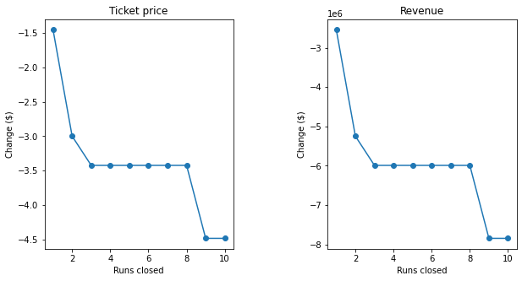
Modeling results
In the first modeling scenario, we utilised a range input to determine with greater certainty how the ticket price support will change with the increasing the number of closed runs.
We found the price support saw the biggest drops for closing 2 runs and 8 runs, between those runs the effect was minimal. That essentially means that if the company wants to close 3 runs, the support for the price will be equal to closing 7 runs.

Slide 6
Modeling Results
The second scenario added major ski attractions, that would result in perhaps increased customer traffic.
The model predicted that the additions would provide support an increase in the ticket price up to $1.36, and an increase in the total revenue of $2,386,364.
The remaining scenarios had no impact in the ticket price model. This can be due to the fact that the model found these attractions to have minimal impact on consumer attraction.

Slide 7
Conclusion
If Big Mountain Resort desires to increase the price of their tickets, then they should follow the business plan utilised in scenario 2: add another run, install 150 ft to the current vertical drop, and add an additional chair lift. It may attract new customers,and will certainly justify higher prices.
If Big Mountain desires to lower the price of their tickets, they should utilise scenario 1: cut either 2 runs or 8 runs, because they cause the greatest shifts in the ticket price support.
I would recommend Big Mountain Resort base this decision on the demographics on their customers. If their customers are of a higher tax bracket, then they may be more price elastic, than say if the lodge mainly is for local Montana residents, than a price increase may drive away customers.

